Slide 1
ARTIFICIAL INTELLIGENCE 2
Overfitting & Underfitting
Lab Presentation

Slide 2

who is which?
Model learns training data too well, including noise → poor performance on new data.
Overfitting
Model is too simple, fails to learn from training data → poor performance on all data.
Underfitting

Slide 3
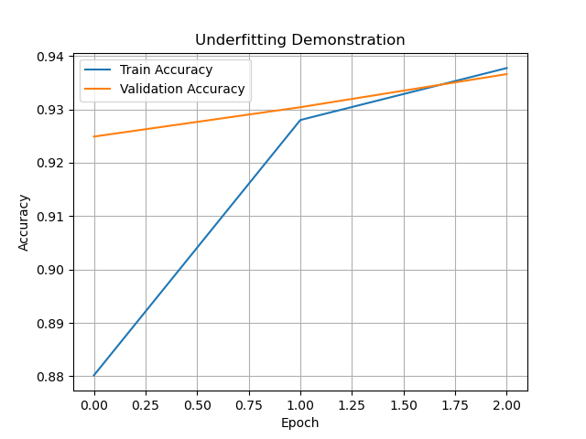
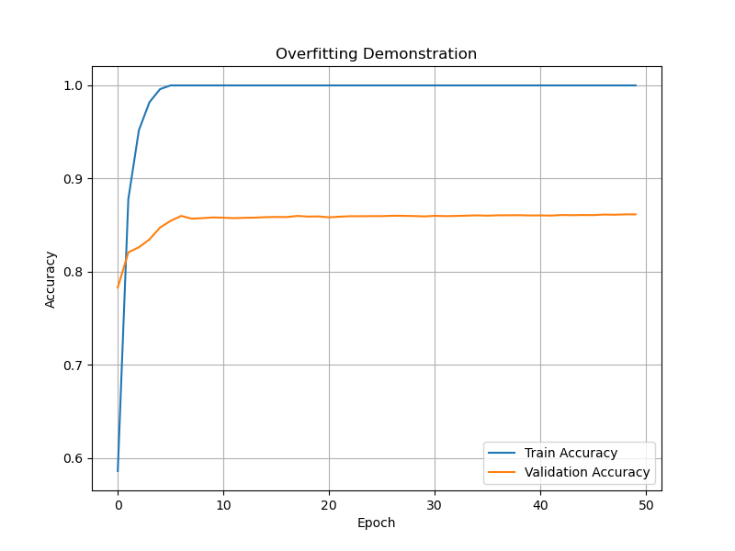
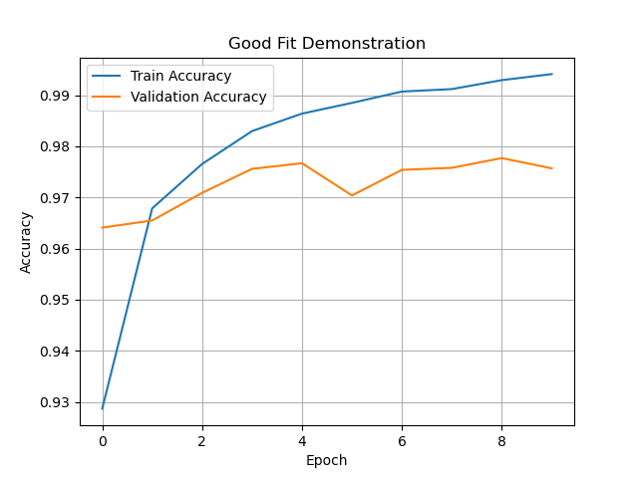
underfitting
overfitting
Good fit

Slide 4
Train vs validation accuracy
Train Accuracy = how well the model performs on the training data
> T.A. Analogy = Like studying the answers for a test in advance and getting them right — but only on practice tests.
Validation Accuracy = Accuracy on unseen dataset; It reflects the model’s ability to generalize
> Analogy = Taking a new test on the same subject — but with different questions. A good model should still do well here.

Slide 5
General understanding
Overfitting
Underfitting
Ideal Fit
High Train + Low Validation
Low Train + Low Validation
High Train + High Validation

Slide 6
Causes for these 2 “errors”
Overfitting:
- Too complex model
- Too few samples
- Too many epochs
- No regularization
Underfitting:
- Too simple model
- Too few epochs
- Poor features or low capacity

Slide 7
01.
Overfitting example
Time to open the IDEs!

Slide 8
02.
Underfitting example
Keep those IDEs open!

Slide 9
How to handle/avoid overfitting
01.
02.
03.
More data
Simpler model
Early stopping
Use more training data to reduce variance and noise effects.
Simplify the model by reducing the number of layers or units.
Use early stopping to halt training when validation loss starts increasing.

Slide 10
How to handle/avoid underfitting
01.
02.
03.
More training
More complex model
Better features
Train longer so the model has time to learn from the data.
Add more layers or neurons to increase model capacity.
Use better feature engineering or more informative input data.

Slide 11
03.
Good fit example
Time to open the IDEs…again!

Slide 12
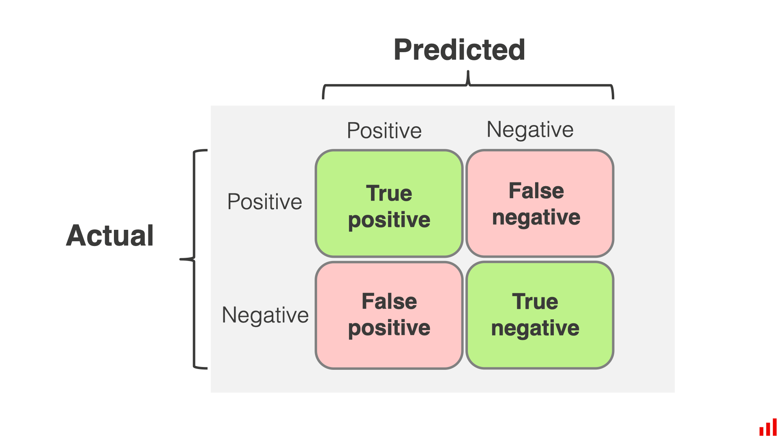
Confusion matrix
A “Confusion matrix” shows how well a clasification model performs.
Each row = actual class
Each column = predicted class

Slide 13
True positive (tp)
False positive (fp)
True negative (tn)
Model correctly predicts positive class.
Model incorrectly predicts positive.
(Type I Error)
False negative (fn)
Model correctly predicts negative class.
Model incorrectly predicts negative.
(Type II Error)

Slide 14
What does positive/negative mean?
"Positive" and "Negative" refer to the target class in binary classification.
"Positive" means the class of interest.
"Negative" means the other class.
These terms do not refer to numerical values in the matrix — they're logical labels.
Accuracy = (TP + TN) / (TP + TN + FP + FN)
----------------------------------------------------------------
The diagonal values in a confusion matrix (TP and TN) represent the correct predictions.

